Slide 1

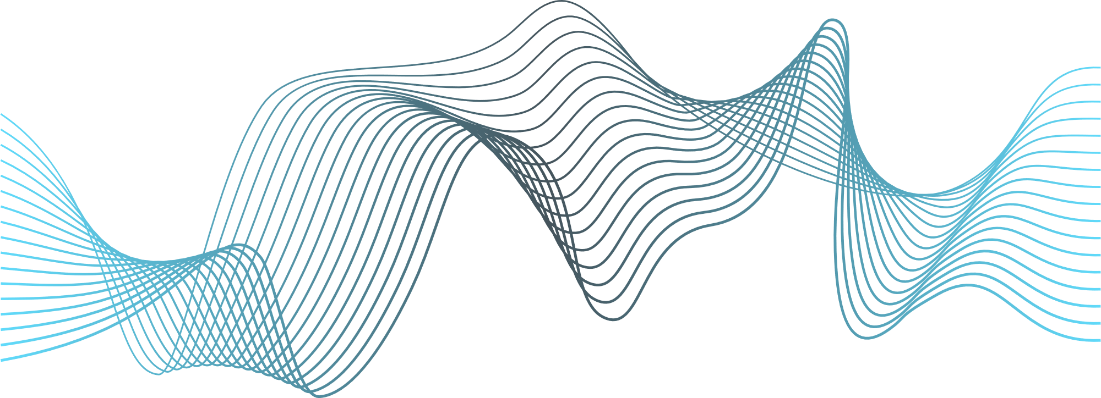

React JS
By : Mahmoud Abdelaziz

Slide 2



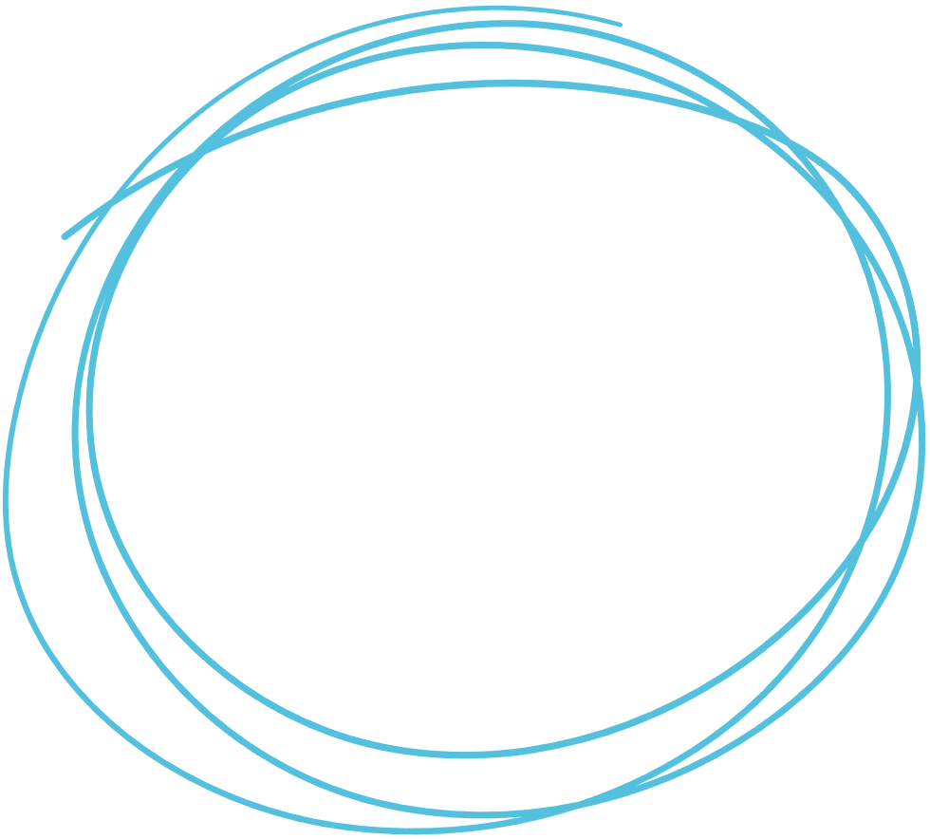


Framework vs Library
React
?

Slide 3
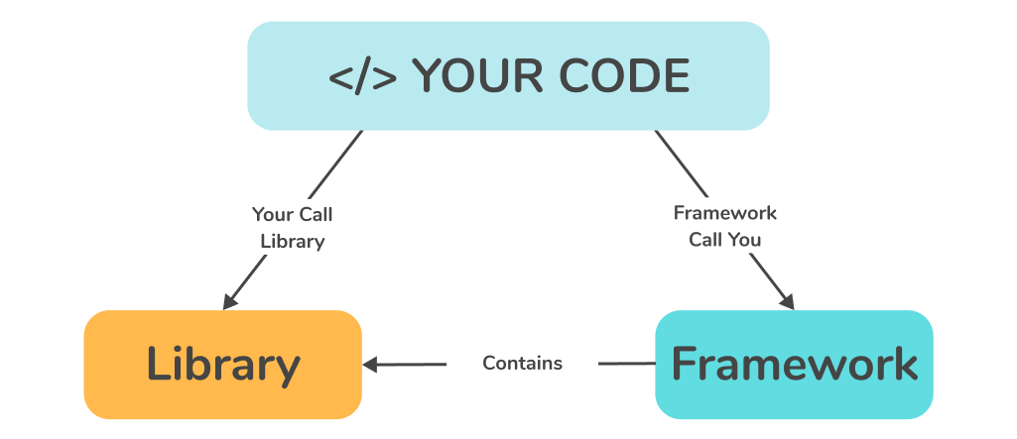


Slide 4





Slide 5


Why React.js ?
React.js was created by Jordan Walke, a software engineer at Facebook.
He developed React in 2011.
React was first used in Facebook's news feed and 2012 on Instagram
before being open-sourced in 2013. Since then, it has grown to become one of the most popular libraries for building web applications.

Slide 6
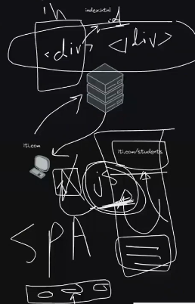
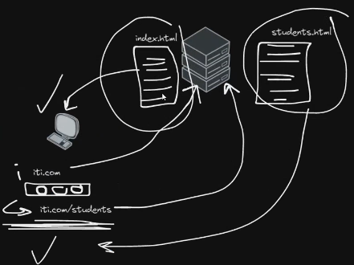

MPA vs SPA

Slide 7

CONTENT
Must
Should
Could
JSX
jsx syntax limitations
Class vs Fn. Component
State & Props &children props🔹
Life Cycle Methods
Events
🔹
Form
Routing
Styling
Pure Components
React hooks
Context API
React.Lazy
Lifting State up
uuid ,conditional Render
Call Api
🔹

Slide 8
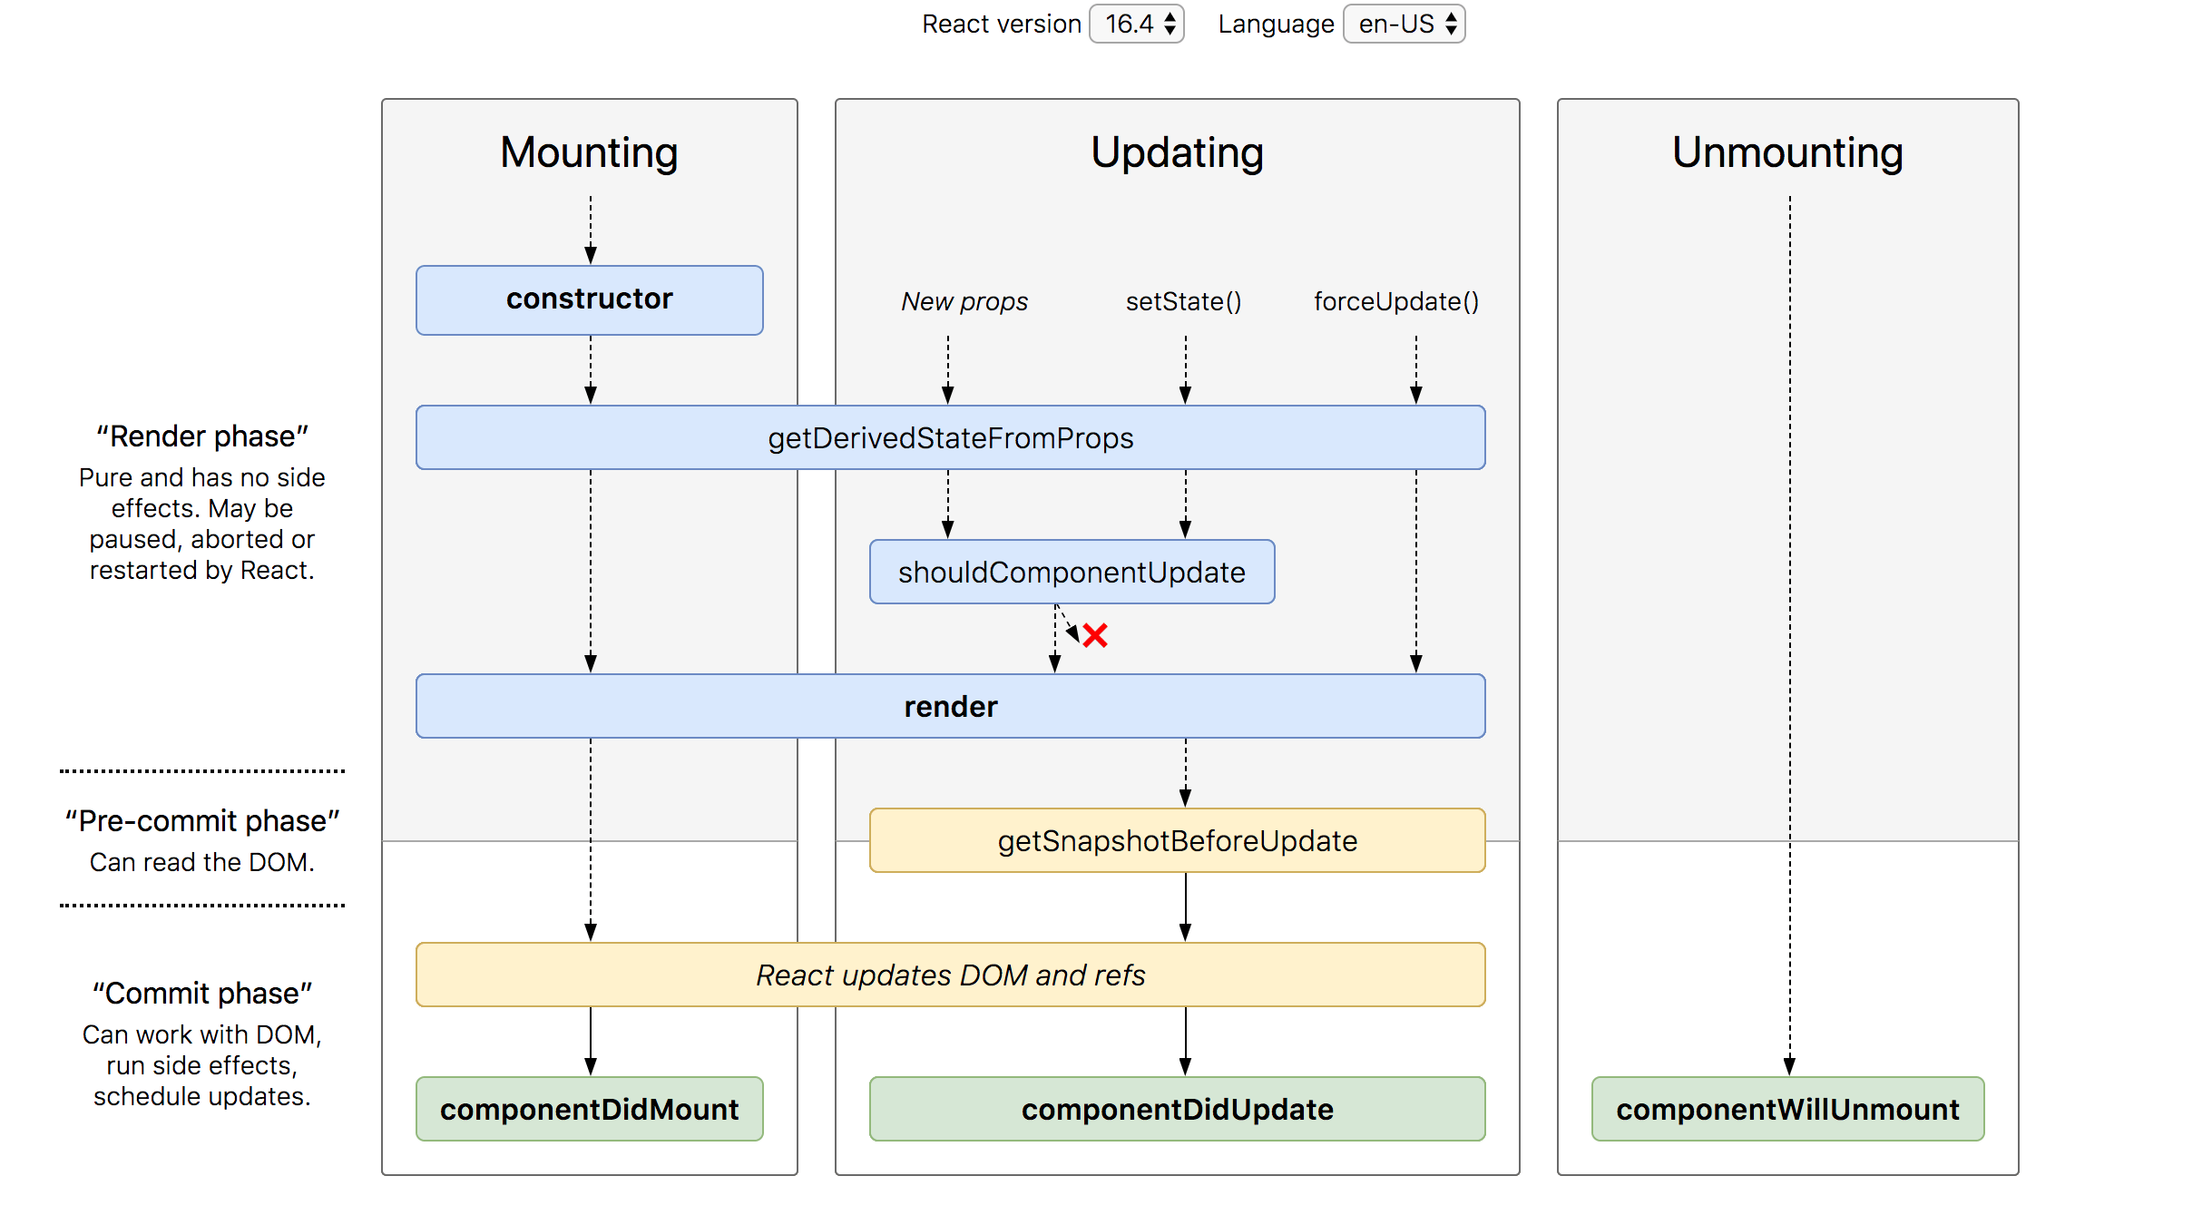


Slide 9


React Hooks

Slide 10

Why Hooks
Making Function Components its own state. Not Only that!
Classes confuse both people and machines.
It’s hard to reuse stateful logic between components.
Complex components become hard to understand.
And more awesome powerful functionalities which we will discover some of them through our Demo.
Used in func comp or in custom hook only
10

Slide 11
Content
Must
should
could
React Hooks
useState
useEffect
React Router Hooks
useHistory =>useNavigate
useLocation
useParams
useRouteMatch
React.lazy
React Hooks
useReducer
useCallback
Redux Hooks
useStore
useSelector
useDispatch
Context API
React.Profiler
React Hooks
useMemo
useDebugValue
useContext
useRef
useLayoutEffect
11

Slide 12
Versions RoadMap
Feature / Description | Version | Release Date
1st Version of React.js | 0.3 | May, 2013
Context API | 16.3 | March, 2018
React.lazy | 16.6 | October, 2018
React Hooks | 16.8 | February, 2019
React.Profiler | 16.9 | August, 2019
Latest Major Release | 18.0 | 29 March, 2022
Latest | 18.2.0 | 14 June 2022
12

Slide 13

Thank You
mahmoudabdelazizibrahim11@gmail.com

